Slide 1

Singular Value Decompostion(SVD) and CNN for Image Processing
Bikramjyot Singh
25MA60R24
Department of Mathematics
Indian Institute of Technology Kharagpur 08:10:25
Bikramjyot Singh
SVD &CNN
5 October, 2025
1 / 38

Slide 2
Table of Contents
Image Processing-
Motivation
Definition of SVD
Full and reduced forms
Low-Rank Approximation Compression Denoising
Convolutional Neural Network for
Denoising
More SVD applications
Gaussian Transformed Feature Extraction
Denoising
PCA

Slide 3

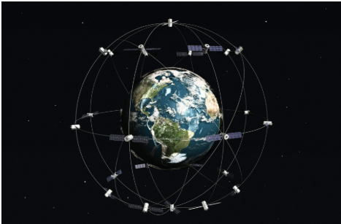
Introduction to Image Processing
Image processing is essential in modern computing for tasks like enhancement, recognition, and compression.
It allows extraction of meaningful information from digital images using mathematical models and algorithms.
Applications: medical imaging, satellite data analysis, autonomous vehicles, and computer vision systems.

Slide 4
Problem Statement: Why Image Processing is Needed
Problem Statement: Image Processing using Singular Value Decomposition and Image Denoising using peek salt filter and properly by CNN and comparing results using Peak Signal To Noise Ratio
Images captured in real-world conditions often contain noise due to sensors, transmission, or environment.
The goal is to remove noise while retaining important details and structures in the image.
One of the optimal solution is to use Convolutional Neural Networks (CNNs) that learn noise patterns and restore high-quality images.

Slide 5
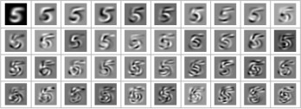
Motivation
Machine learning: feature extraction
image credits: https://mathematicaforprediction.wordpress.com/

Slide 6
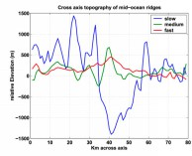
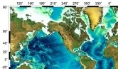
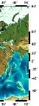
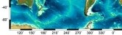
Motivation
Scientific computing: 3D reconstruction
(a) Topography data
(b) 3D reconstruction
image credits: http://www.columbia.edu/

Slide 7
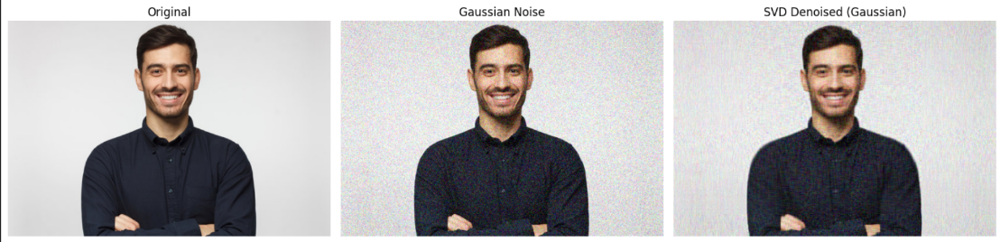
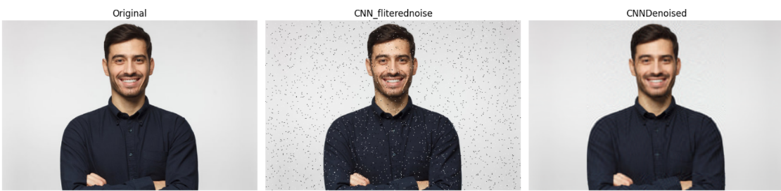
Subhadip Chowdhury
Decision Tree
20 August, 2025
7 / 38

Slide 8
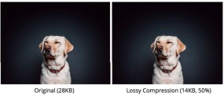

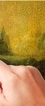
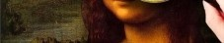
Motivation
Singular Value Decomposition (SVD) has been applied in a wide range of fields:
Computer vision: image compression and denoising
Computer vision: steganography
image credits: google image

Slide 9
Singular Value Decomposition- Diagonalization of non square matrix on rank(A)=r for A=U*S*V.T
The SVD of a matrix A □R^{m×n} is a factorization A = U^{ˆ}Σ^{ˆ}V ^{T}
where
Σ^{ˆ} □R^{n×n} is a diagonal matrix of singular values sorted in descending order, σ1 ≥ σ2 ≥ ...σn
U^{ˆ} □R^{m×n} has orthonormal columns - left singular vectors
V □R^{n×n} has orthonormal columns - right singular vectors

Slide 10
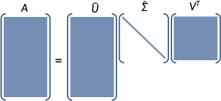
Singular Value Decomposition -Applications
In applications, we will often think of A as a tall, thin matrix, representing relatively few n samples in a high m-dimensional space, though the SVD is defined for any matrix. For m > n, the columns of U^{ˆ} can be padded with m − n arbitrary orthonormal vectors to obtain a full m × m matrix U, and Σ^{ˆ} padded with rows of zeros to null the contribution of these columns.

Slide 11
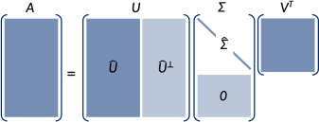
Singular Value Decomposition
Redu
ced SVD of A:
Full SVD of A:

Slide 12
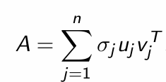
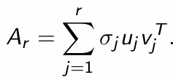
Low-Rank Approximation
The SVD provides a natural hierarchy of approximations we can make to A, expressed as a sum of rank-one matrices. If
where each ujv ^{T} is a rank-one matrix whose columns are all
j
smultiples of each other, then a rank-r approximation Ar of A is

Slide 13
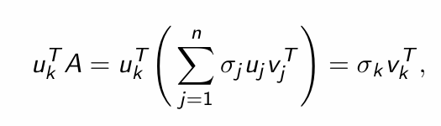
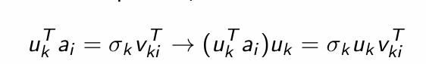
Low-Rank Approximation
Note that by the orthogonality of the columns of u,
_{Σ}n
!
so for a particular data point ai that is the i^{th} column of A,
is the projection of ai onto the k^{th} left singular vector u_{k}. So another way to think about the low-rank approximation is that it is a sum of projections onto a limited number of left singular vectors.

Slide 14
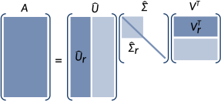
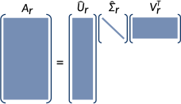
Low-Rank Approximation
Reduced SVD of A:
Rank-r approximation of A:

Slide 15
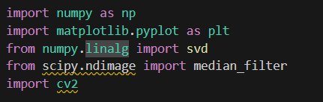
Singular Value Decomposition & CNN and Used Libraries
In Python:
1
2
3
4
import numpy as np
A = np.random.rand(20, 5)
U, s, Vt = np.linalg.svd(A) # full SVD
U, s, Vt = np.linalg.svd(A, full_matrices=False) # reduced

Slide 16
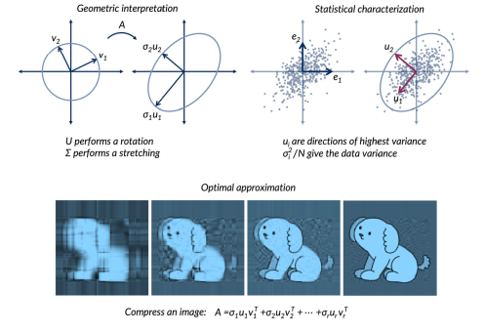
SVD viewed under different lenses

Slide 17
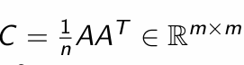
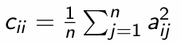
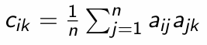
Principal Component Analysis
The left singular vectors u1,u2,...,un form a rotated, orthonormal basis for the m-dimensional space occupied by the columns of A, a1,a2,...,an (data points).
This new basis is oriented such that u1 points in the direction along which the data has the largest variance, u2 points along the direction of next-largest variance orthogonal to u1, and so on.
How?
Consider the covariance matrix, where
n
the diagonals along the i^{th} axis
the off-diagonals the i^{th} and k^{th} axes.
give the variance of the data
give the covariance along
jk

Slide 18
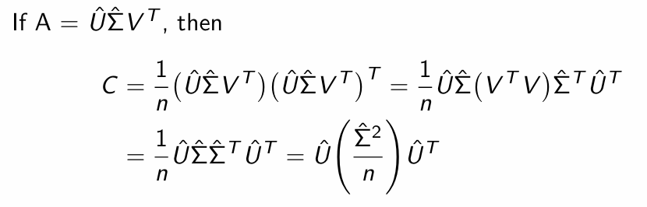
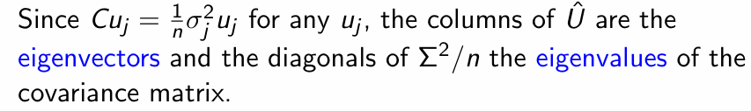
Principal Component Analysis
The eigenvalues once again represent the variance of the data, now along the rotated axes u1,...un. These axes are called principal components in PCA, but they are the same as left singular vectors!

Slide 19
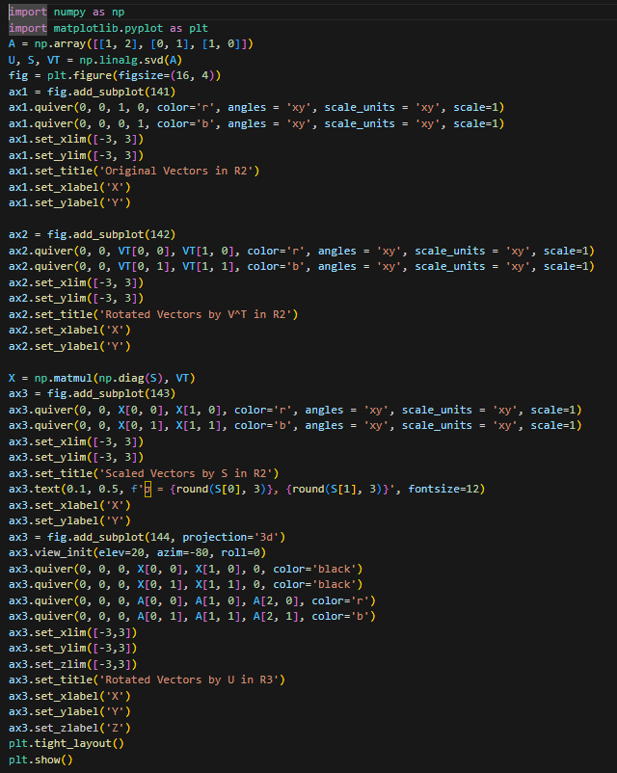
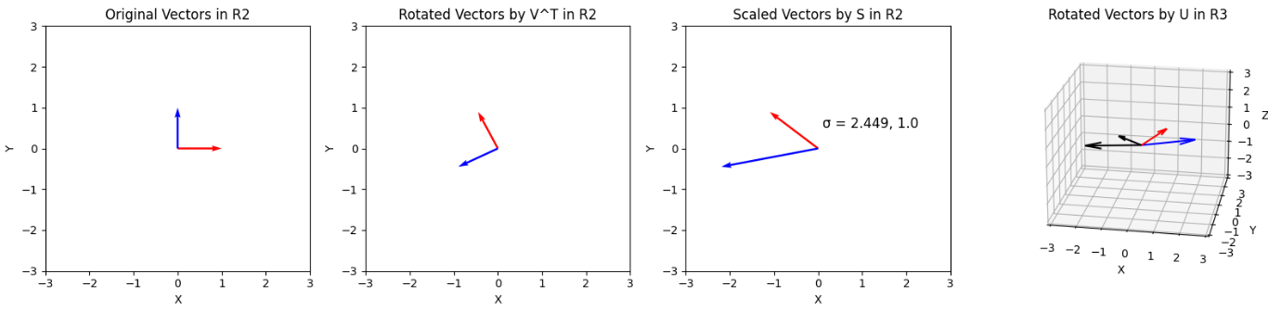
SVD transformed U,V.T vectors in m , n dimension respectively

Slide 20
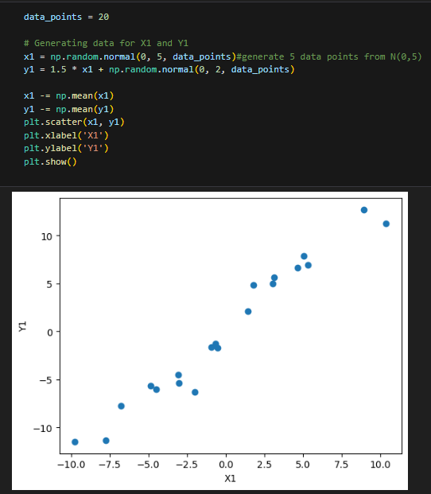
Example –SVD examined by matrization of gaussian dataset

Slide 21
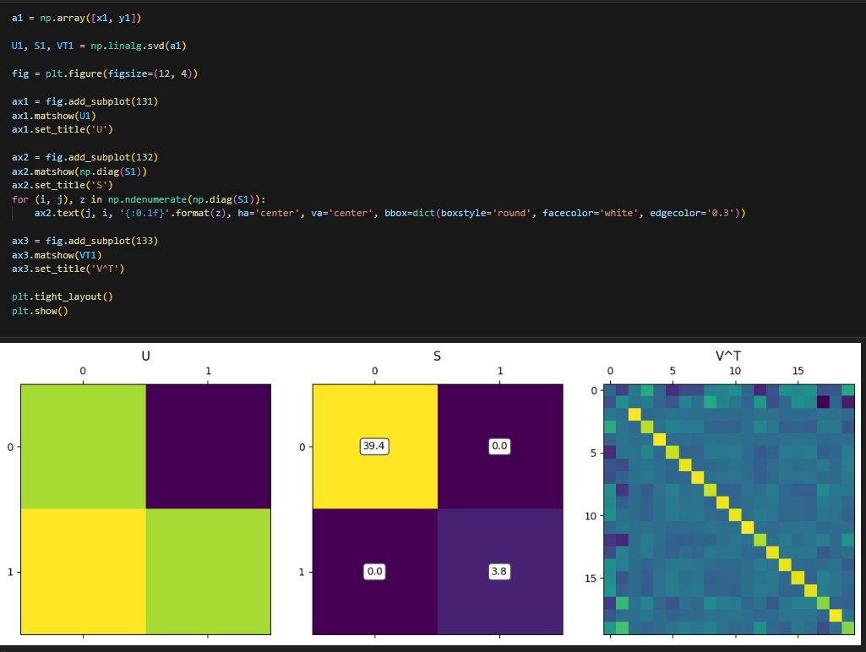
Example –After applying SVD on Gaussian Variables Matrix The Alignments of U,S,V.T

Slide 22
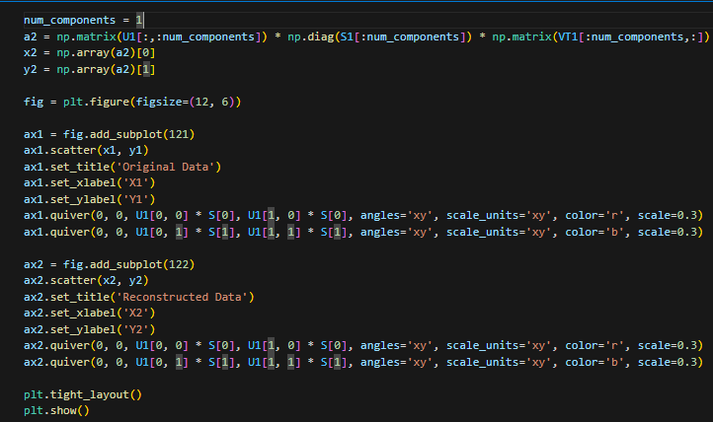
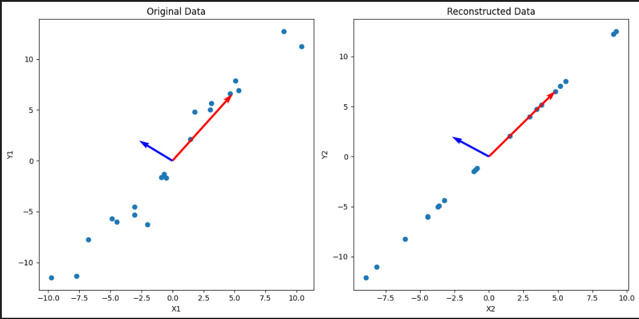
Example –After applying SVD on Gaussian Variables Matrix The Alignments of U,S,V.T

Slide 23

Now applying SVD and CNN on this Image (CNN majorly used for denoising using filters) and Image denoising also done using gaussian noise elimination

Slide 24
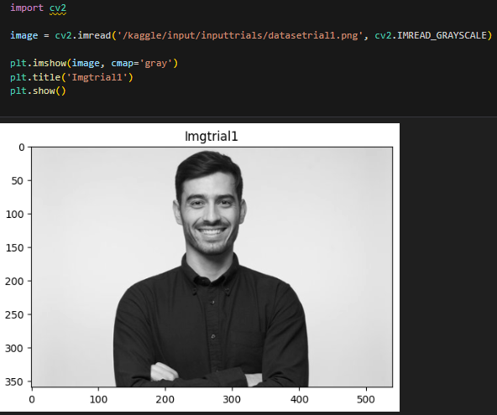
Conversion to Gray Scale -

Slide 25
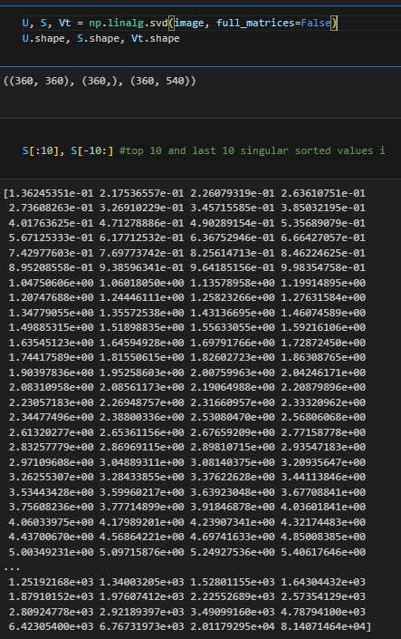
SVD applied to Gray Scale shape of U,S,V.T with sorted S in Descending Order

Slide 26
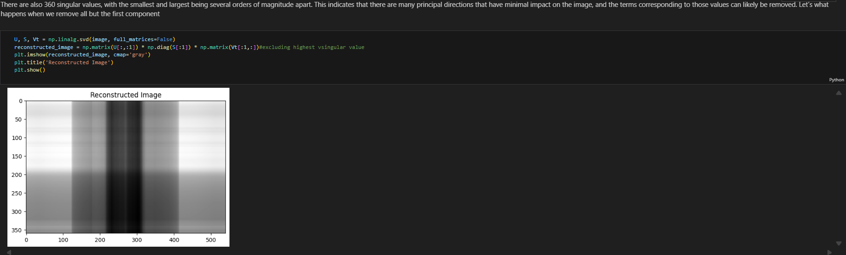
SVD applied to Gray Scale shape of U,S,V.T with sorted S in Descending Order without first and Highest Singular Value

Slide 27
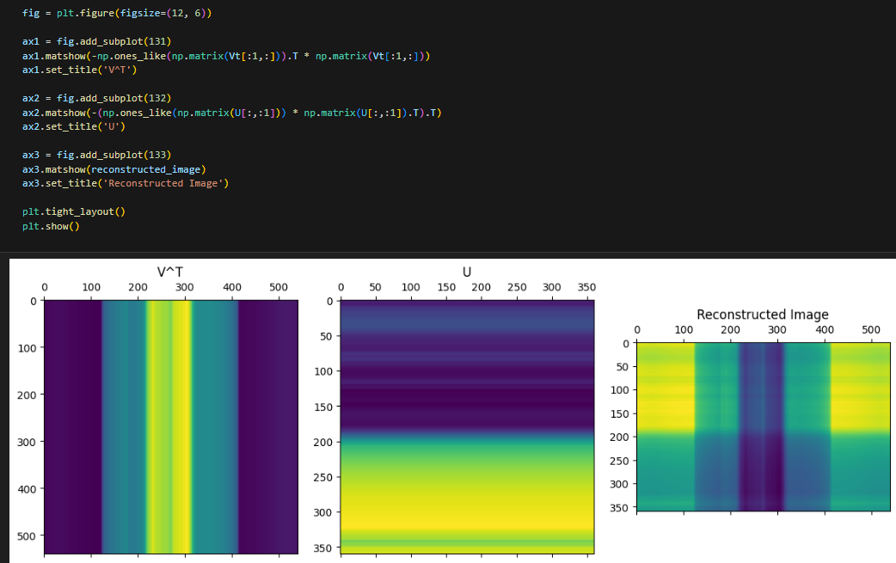
SVD applied to Gray Scale shape of U,S,V.T with sorted S in Descending Order and Reconstructed with merging U,S,V.T with left U and right V vector values

Slide 28
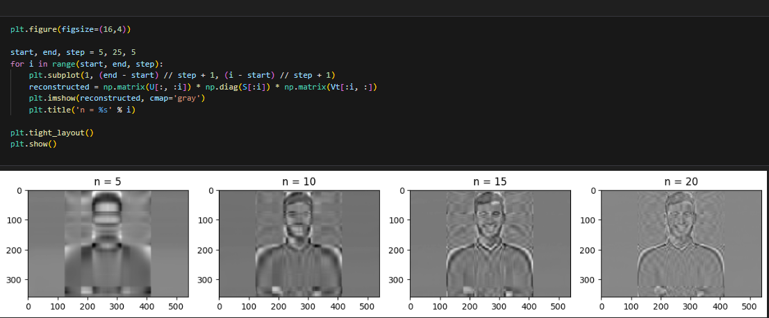
SVD applied to Gray Scale shape of U,S,V.T with sorted S in Descending Order exploring of N with step size =5 from 5 to 25

Slide 29
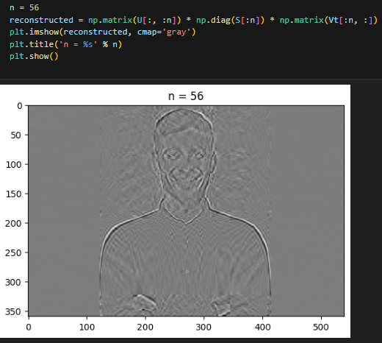
SVD applied to Gray Scale shape of U,S,V.T with sorted S in Descending Order exploring of N and optional value fits with N=56 top singular vectors

Slide 30
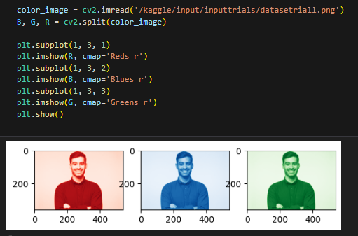
SVD applied to Gray Scale shape of U,S,V.T with sorted S in Descending Order split after optimal N into Red ,Green ,Blue Channels with 200 pixel size

Slide 31
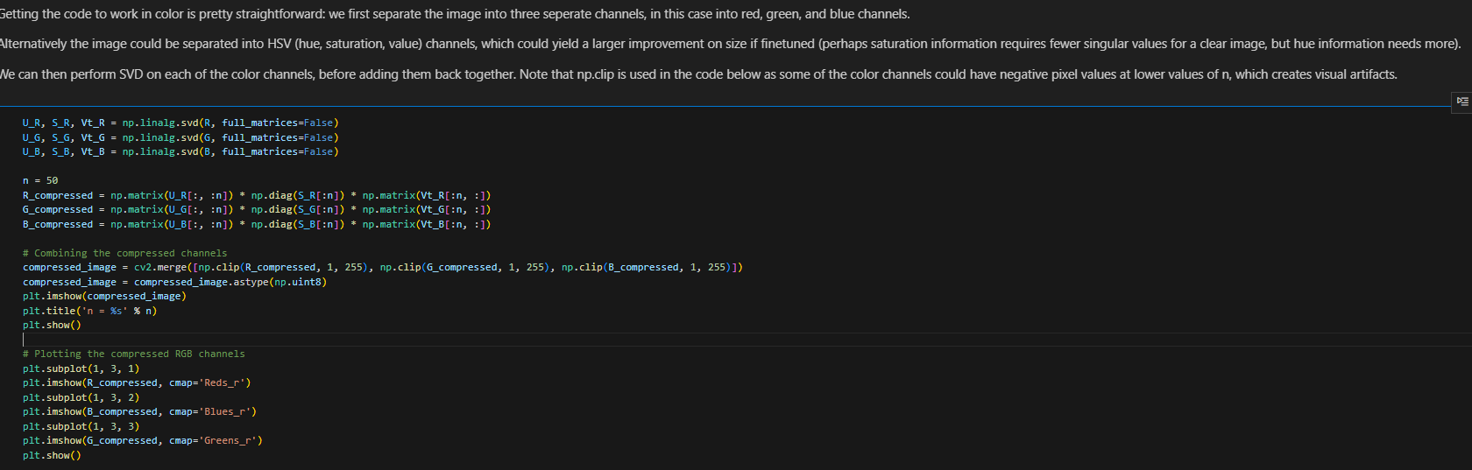
SVD applied to Gray Scale shape of U,S,V.T with sorted S in Descending Order split after N=50 or 56 same thing and now the code to regenerate the image

Slide 32
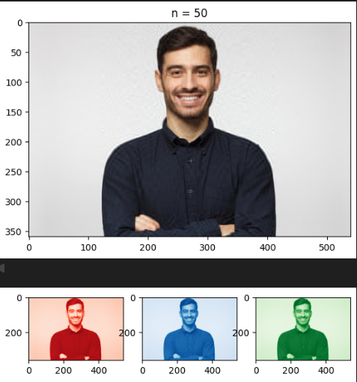
SVD applied to Gray Scale shape of U,S,V.T with sorted S in Descending Order with Reconstructed Image output with {R ,G, B} links

Slide 33
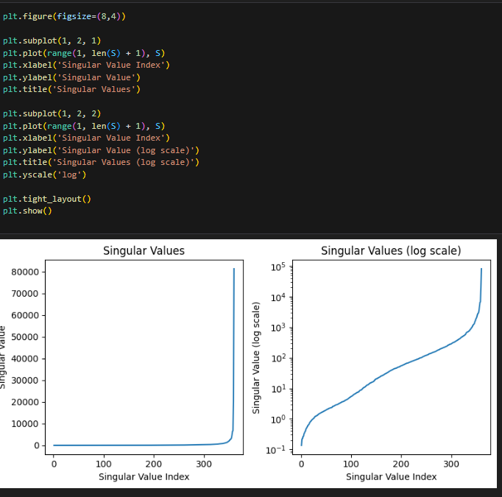
SVD applied to Gray Scale shape of U,S,V.T with sorted S in Descending Order with SVD singular value plots and log scale plot

Slide 34
SVD applied to Gray Scale shape of U,S,V.T with sorted S in Descending Order Anomalies
1)
Computational intensity due to matrix multiplications involved in reconstruction of image ,for finding U and V .
2)
If there is discrete image containing noise then it must be very difficult to detect the image as the difference in the magnitudes will be greater than those in noiseless image hence those were easily reduced to zero what now required in the summation here the magnitude is high due to intensity of the image Then by applying SVD could lead to generate noisy components in images and generate errors in the reconstructed image.

Slide 35
SVD applied to Gray Scale shape of U,S,V.T with sorted S in Descending Order to tackle anomalies-
1)
Image Denoising using Salt and Pepper Denoising filter (Gaussian) with dimension=3
2)
Convolutional Neural Networks (CNN) using denoised filters
learn noise patterns and restore high-quality images.

Slide 36
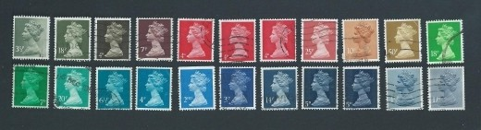
Image Denoising
Retaining a low-rank approximation of an image can also be a technique for denoising.
Consider the set of N = 22 stamps below, which all have similar features, but are obscured by different black mail markings.

Slide 37
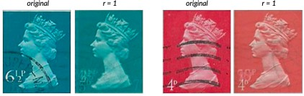
Image Denoising
In this example, we consider each m × n × p color image as a single sample of length mnp, where p = 3, and assemble a matrix
_{S □R}3mn×N .

Slide 38
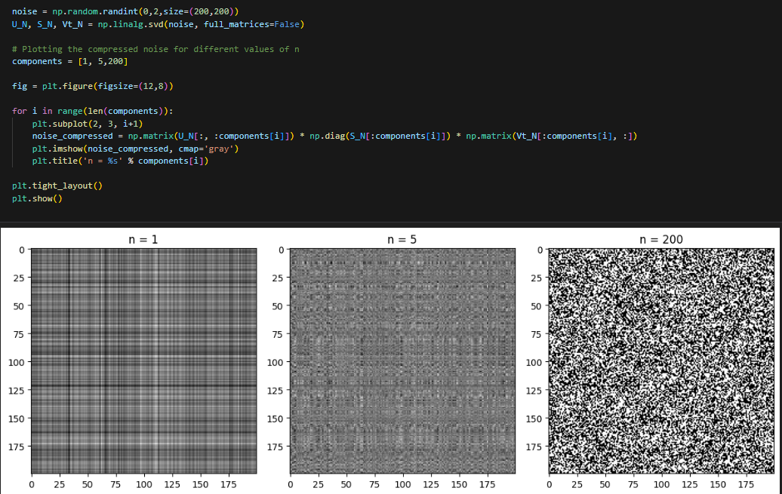
Image Denoising
The singular vectors can be used to construct a lower-dimensional space that captures the most significant features of the data. This forms the basis of PCA and selection of the non-noisy singular vectors and with maximum k values .The singular vectors containing noisy ones would have their weights near to 0 after denoising it. Taking out the noisy part from the image at every n

Slide 39
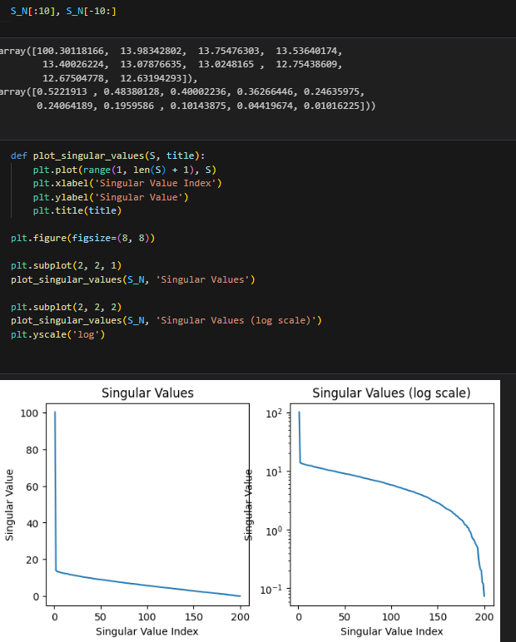
Image Denoising
By without the noisy components let’s visualize the plots and values of singular values which are not normalized in between 0,1 and becomes >1 . The plot becomes reversed when compared to the previous plots with non noisy extracted and information stored in each singular value or weights will reduce.

Slide 40
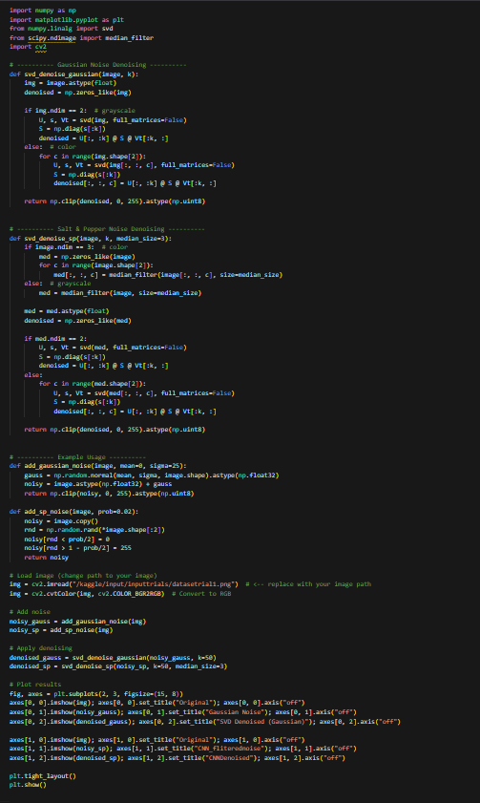
Image Denoising
Now the noise was extracted using this noise denoise peek salt filter
using the provided code and output as follows-

Slide 41
Image Denoising
Now the noise was extracted using this noise denoise peek salt filter
using the provided code and output as follows-

Slide 42
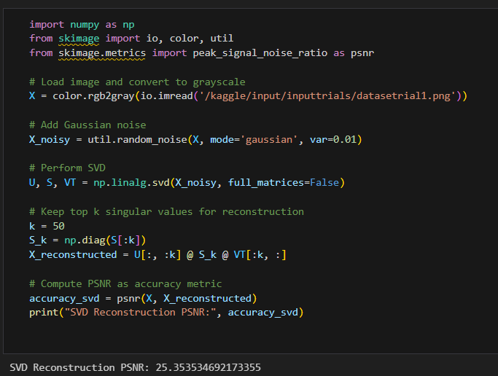
Image Denoising
Now the noise was extracted using this noise denoise peek salt filter
which has the PSNR accuracy score of 25 .358(87 percent enhancement of original image) PSNR measures how close denoised image is with the original to higher with the better quality.

Slide 43
Introduction to Convolutional Neural Networks (CNNs)
CNNs are deep learning models specialized for grid-like data such as images.
Core Components: Convolution Layers, Activation (ReLU), Pooling Layers, Fully Connected Layers.
CNN is used for Image Processing for preserving spatial locality, learn hierarchical features, and perform effective noise reduction.

Slide 44
CNN Denoising Architecture goals and basic architecture
The goal is to remove Gaussian noise from grayscale image using CNN autoencoder-like design.
Architecture: 3 convolution layers for feature extraction and reconstruction.
Training: Input = Noisy image, Target = Clean image, Loss = MSE, Optimizer = Adam.

Slide 45
CNN Denoising Results and Metrics
Process: Convert → Add noise → Train CNN → Reconstruct image → Compute PSNR.
PSNR measures how close denoised image is to original — higher = better quality.
CNN learns to map noisy → clean images using feature extraction and reconstruction.

Slide 46
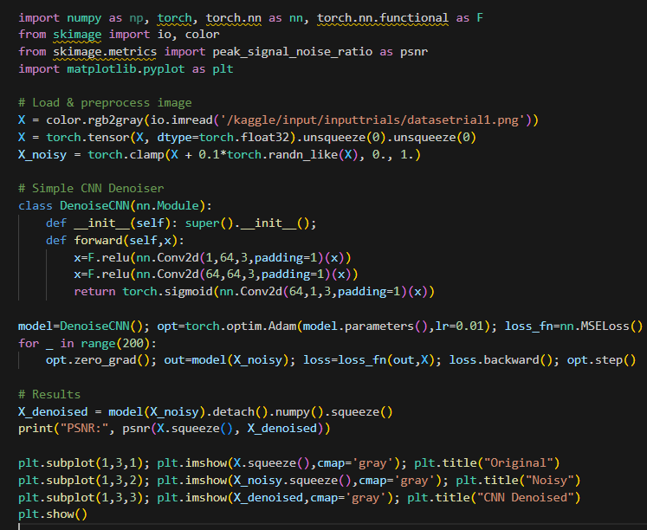
CNN Denoising Results and Metrics
Process: Convert → Add noise → Train CNN → Reconstruct image → Compute PSNR. Provided code -

Slide 47
CNN Denoising Results and Metrics
Process: Convert → Add noise → Train CNN → Reconstruct image → Compute PSNR. Output for the following code is

Slide 48
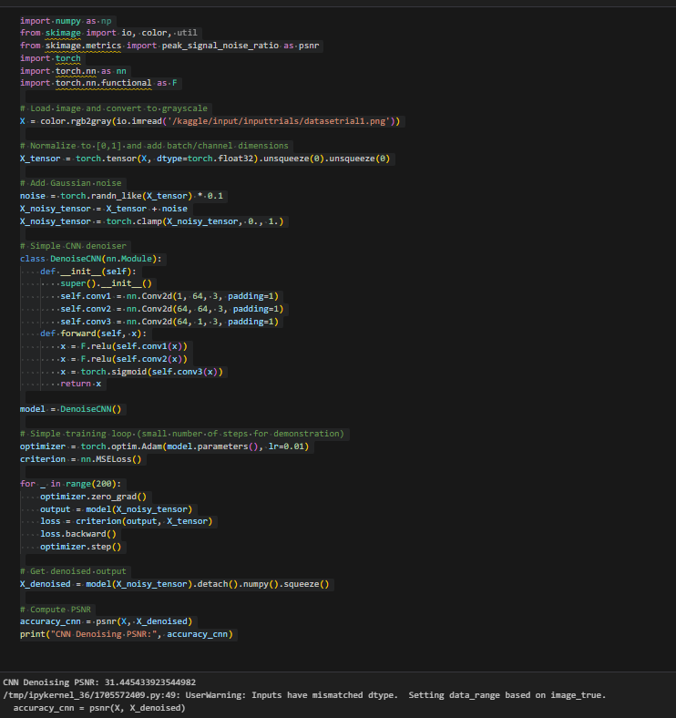
CNN Denoising Results and Metrics
Process: Convert → Add noise → Train CNN → Reconstruct image → Compute PSNR. The PSNR value is 31.44 nearly(97 percent of the original image with enhanced features and no noise ).

Slide 49
Conclusion
The comparison of denoising performance between Singular Value Decomposition (SVD) and Convolutional Neural Network (CNN) highlights the superior capability of CNNs in preserving image quality. The PSNR value for SVD-based denoising was 25.35, indicating a moderate restoration of the original image, while the CNN-based denoising achieved a PSNR of 31.44, reflecting significantly higher fidelity and noise reduction. Thus, CNNs outperform traditional SVD methods by effectively learning and removing complex noise patterns, producing cleaner and more visually accurate results.

Slide 50
References
Brunton, Steven L., and J. Nathan Kutz. ”Chapter 1: Singular Value Decomposition.” Data-driven science and engineering: Machine learning, dynamical systems, and control. Cambridge University Press, 2019.
https://dmicz.github.io/machine-learning/svd-image-compression/
https://www.appliedaicourse.com/blog/singular-value-decomposition-svd-in-machine-learning/
https://www.geeksforgeeks.org/machine-learning/singular-value-decomposition-svd/
For other code and resources ,please refer to my github account and Kaggle sync with github Link:-

